Slide 1
KeyStroke Logging on Browser
18BIT0101 - Kuhoo Sharma

Slide 2
Keylogging
Keystroke loggers or Keyloggers are the hardware programs or software programs that support close monitoring of the keyboard by recording keystrokes made by a user, often in a covert manner or secretive manner so that users don’t know that their actions/activity is being monitored[

Slide 3

Keylogging on Browser
Browser Extensions /Plugin
Browser extensions are mini-applications within a browser that add functionality.
They add functionality within one or two clicks. Extensions are very useful, but if the developers have wrong intentions or extensions fall into the wrong hands, it is also very dangerous.

Slide 4
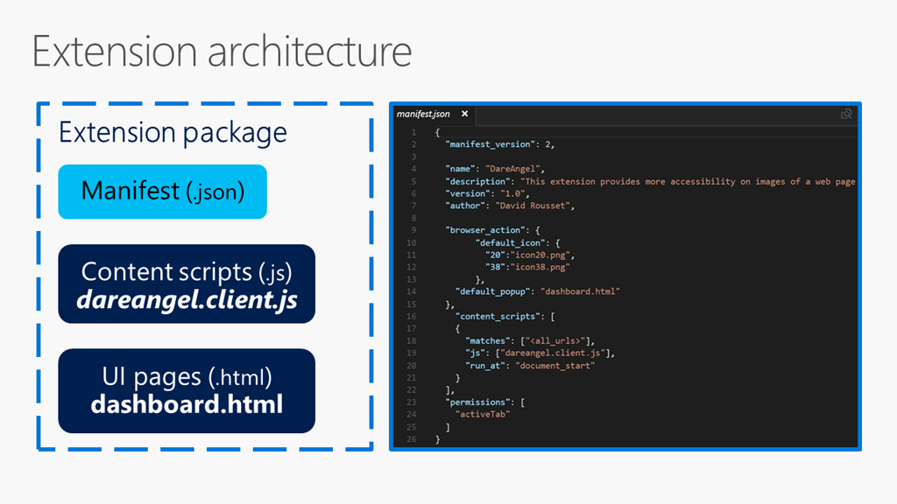
Keylogging on Browser
Browser Extensions /Plugin
Why on Browser ?
Capture all keyboard input.
Log all user activity (websites visited)
Complete access to DOM
Can retrieve passwords as well as cookies

Slide 5
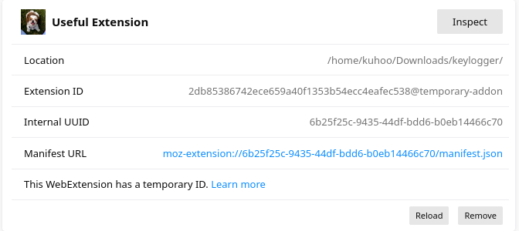
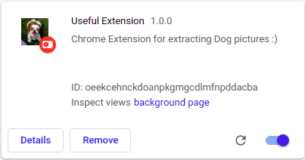
Keylogging on Browser
Browser Extensions /Plugin
Why on Browser ?
Can Act as a Trojan
Unknowingly monitor the user
Not detectable by AV unless browser plugin implemented
← FireFox
Chrome →

Slide 6
Logs :
Websites visited by user
Activity timing
Special Keys
Users keyboard input( passwords, searches etc)
Cookies

Slide 7
Implementation

